Slide 1

What is DataBase?!
A database is an organized collection of data, generally stored and accessed electronically from a computer system.
Databases are structured to facilitate the storage, retrieval, modification,
and deletion of data in conjunction with various data-processing operations.
Types Of DataBase
1. Relational Databases (RDBMS)
2. Non Relational Databases (N-RDBMS)
By Eslam Khder

Slide 2
Structure: Data is organized into tables (relations) with rows and columns.
1. Relational Databases (RDBMS)
Structure: Data is organized into tables (relations) with rows and columns.
Examples: MySQL, PostgreSQL, Microsoft SQL Server, and Oracle Database.
Use Cases: Suitable for applications requiring complex queries,
transaction management, and data integrity..
By Eslam Khder

Slide 3
Structure: Data is organized into tables (relations) with rows and columns.
2. NON Relational Databases
(NoSQL Databases)
Non Structure: Store data as documents, typically in JSON
Examples: MongoDB, CouchDB.
Use Cases: Suitable for applications with flexible schema requirements, high scalability, and performance needs, such as real-time web applications and big data analytics.
By Eslam Khder

Slide 4
We will use Relational Databases (RDBMS)
(Oracle DB)
1. Install Oracle DB
2. Download tool DBeaver
By Eslam Khder

Slide 5
Unlocking the HR Schema
Run this query on commend
sqlplus / as sysdba;
alter session set container=orclpdb;
alter pluggable database open;
alter pluggable database orclpdb save state;
alter user hr identified by hr account unlock;
By Eslam Khder

Slide 6
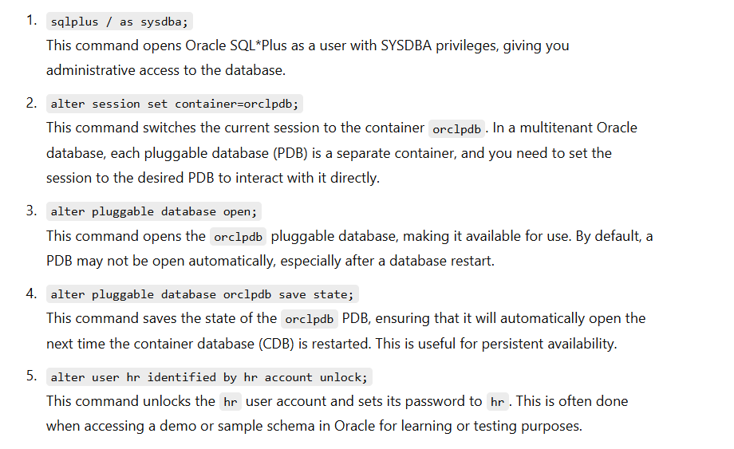
Unlocking the HR Schema
By Eslam Khder

Slide 7
SQL Commands | DDL, DML, DCL
1 - Data Definition Language (DDL) Statements
2 - Data Manipulation Language (DML) Statements
3 - Data Control Language (DCL)
By Eslam Khder

Slide 8
Data Definition Language (DDL) Statements
DDL or Data Definition Language actually consists of the SQL commands that can be used to define the database schema. It simply deals with descriptions of the database schema and is used to create and modify the structure of database objects in the database.
By Eslam Khder

Slide 9
Data Definition Language (DDL) Statements
Command | Description | Syntax
CREATE | Create database or its objects (table, index, function, views, store procedure, and triggers) | CREATE TABLE table_name (column1 data_type, column2 data_type, ...);
DROP | Delete objects from the database | DROP TABLE table_name;
ALTER | Alter the structure of the database | ALTER TABLE table_name ADD COLUMN column_name data_type;
TRUNCATE | Remove all records from a table, including all spaces allocated for the records are removed | TRUNCATE TABLE table_name;
COMMENT | Add comments to the data dictionary | COMMENT 'comment_text' ON TABLE table_name;
RENAME | Rename an object existing in the database | RENAME TABLE old_table_name TO new_table_name;
By Eslam Khder

Slide 10
SQL Commands | DDL, DML, DCL
1 - Data Definition Language (DDL) Statements
2 - Data Manipulation Language (DML) Statements
3 - Data Control Language (DCL)
By Eslam Khder

Slide 11
Data Manipulation Language (DML) Statements
The SQL commands that deal with the manipulation of data present in the database belong to DML or Data Manipulation Language and this includes most of the SQL statements.
By Eslam Khder

Slide 12
Data Manipulation Language (DML) Statements
Command | Description | Syntax
INSERT | Insert data into a table | INSERT INTO table_name (column1, column2, ...) VALUES (value1, value2, ...);
UPDATE | Update existing data within a table | UPDATE table_name SET column1 = value1, column2 = value2 WHERE condition;
DELETE | Delete records from a database table | DELETE FROM table_name WHERE condition;
LOCK | Table control concurrency | LOCK TABLE table_name IN lock_mode;
CALL | Call a PL/SQL or JAVA subprogram | CALL procedure_name(arguments);
EXPLAIN PLAN | Describe the access path to data | EXPLAIN PLAN FOR SELECT * FROM table_name;
By Eslam Khder

Slide 13
DCL (Data Control Language)
DCL includes commands such as GRANT and REVOKE which mainly deal with the rights, permissions, and other controls of the database system.
Command | Description | Syntax
GRANT | Assigns new privileges to a user account, allowing access to specific database objects, actions, or functions. | GRANT privilege_type [(column_list)] ON [object_type] object_name TO user [WITH GRANT OPTION];
REVOKE | Removes previously granted privileges from a user account, taking away their access to certain database objects or actions. | REVOKE [GRANT OPTION FOR] privilege_type [(column_list)] ON [object_type] object_name FROM user [CASCADE];
By Eslam Khder

Slide 14
Data Definition Language (DDL) Statements
Database Object Naming Rules
Database object names must follow some standard rules
1. They should start with a letter.
2. Can contain only A-Z, a-z, 0-9, -, $, and # characters.
3. Can be up to 128 characters in length.12c Release 2
4. Cannot have the same name as another existing object in the same schema.
5. Cannot be a reserved word like SELECT, FROM, UPDATE, DELETE, WHERE, HAVING, etc.
By Eslam Khder

Slide 15
Data Definition Language (DDL) Statements
DataTypes
DESC | Data types
Variable-length character data | VARCHAR2(size)
Fixed-length character data | CHAR(size)
numeric data (precision, scale) | NUMBER(p, s)
Date and time values | DATE
TO Store FILE | CLOB
By Eslam Khder

Slide 16
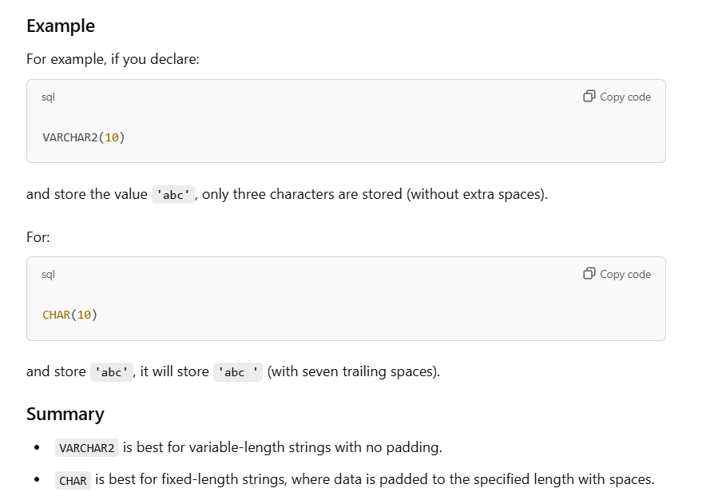
Data Definition Language (DDL) Statements
DataTypes
By Eslam Khder

Slide 17
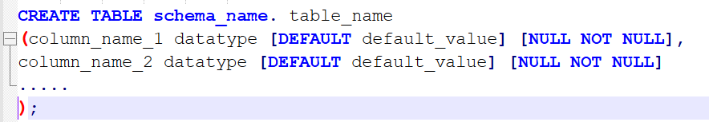
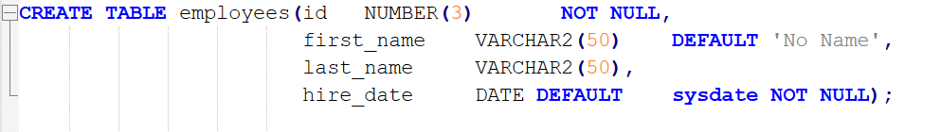

Data Definition Language (DDL) Statements
CREATE TABLE Statement
The CREATE TABLE statement is used to create a new table
To create a table you must have the CREATE TABLE privilege.
By Eslam Khder

Slide 18
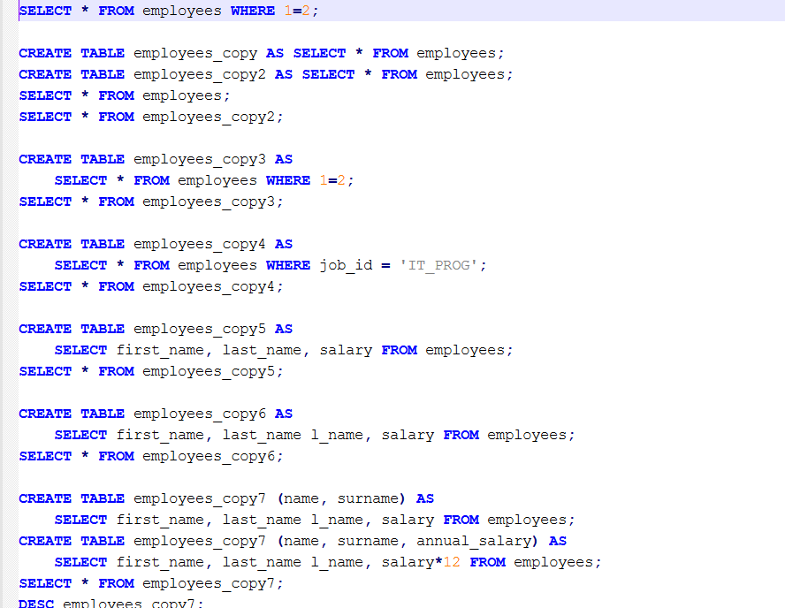
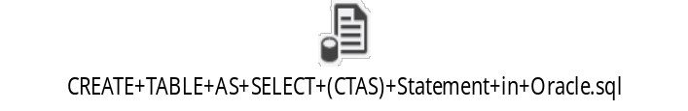
Data Definition Language (DDL) Statements
By Eslam Khder

Slide 19
Data Definition Language (DDL) Statements
ALTER TABLE Statements
The ALTER TABLE statement changes the structure of an existing table.
With the ALTER TABLE command, you can:
* Add one or more new columns to a table.
* Modify the data type of one or more existing columns.
* Drop one or more columns from a table.
* Rename a column or a table.
Much more..
By Eslam Khder

Slide 20
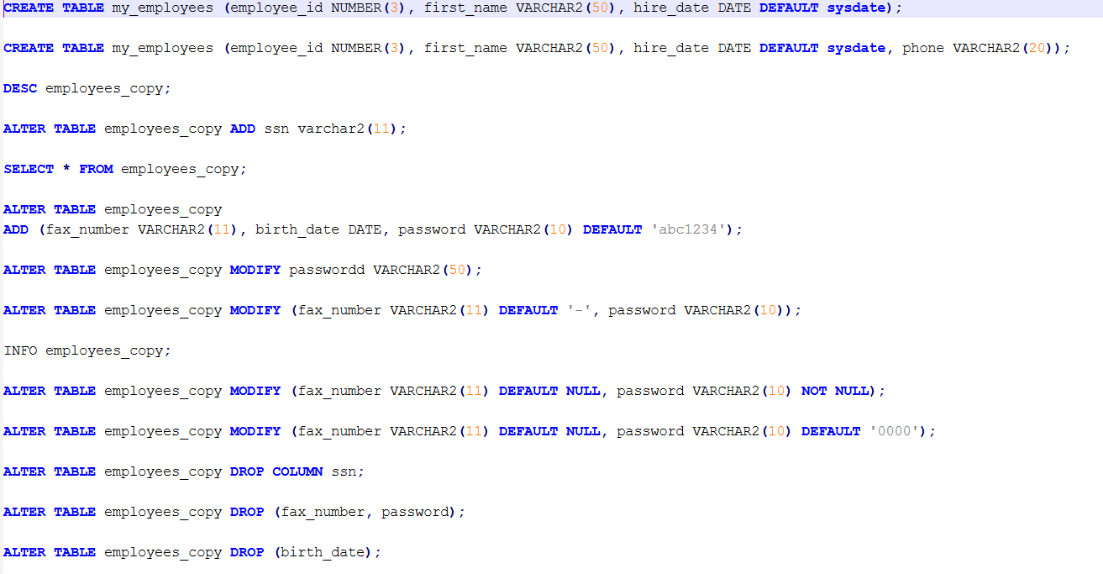

Data Definition Language (DDL) Statements
By Eslam Khder

Slide 21
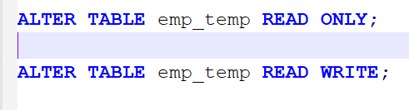
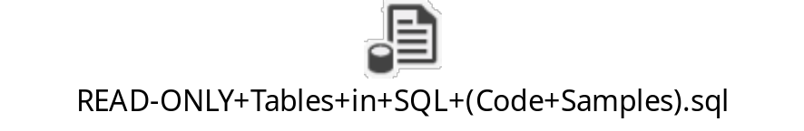
Data Definition Language (DDL) Statements
READ ONLY Tables
Read-only means allowing users to read, but not modify, data
We need to do maintenance on some tables
During these times, we may want to prevent any DML operations and certain DDL statements that affect the data on those tables against any accidental changes
Oracle allows us to create such tables using the "READ-ONLY" feature.The READ ONLY clause is used at the end of the ALTER TABLE syntax to set a table to read-only
To change a read-only table to read-write again, the READ WRITE clause is used at the end of the ALTER TABLE statement.
By Eslam Khder

Slide 22


Data Definition Language (DDL) Statements
The DROP TABLE statement removes an existing table with all its data from the database and moves it to the recycle bin
After dropping a table, we can restore it for a short time using the FLASHBACK TABLE statement.
After dropping a table, all the objects related to that table will also be deleted or become invalid.
By Eslam Khder

Slide 23
Data Definition Language (DDL) Statements
- TRUNCATE TABLE Statement& The DELETE statement deletes all data row by row whereas the TRUNCATE statement deletes all rowfrom a table more quickly
- The TRUNCATE statement is one of the DDL (DataDefinition Language) statements so it willauto-commit changes immediately after removing data.
- TRUNCATE does not allow rollback.
- The data deleted using the TRUNCATE statement cannot easily be restored (FLASHBACK) becauseTRUNCATE does not generate any undo information or log data.
- The TRUNCATE statement works faster than the DELETE statement.
By Eslam Khder

Slide 24
Data Definition Language (DDL) Statements
Why The TRUNCATE statement works faster than the DELETE statement?
By Eslam Khder

Slide 25
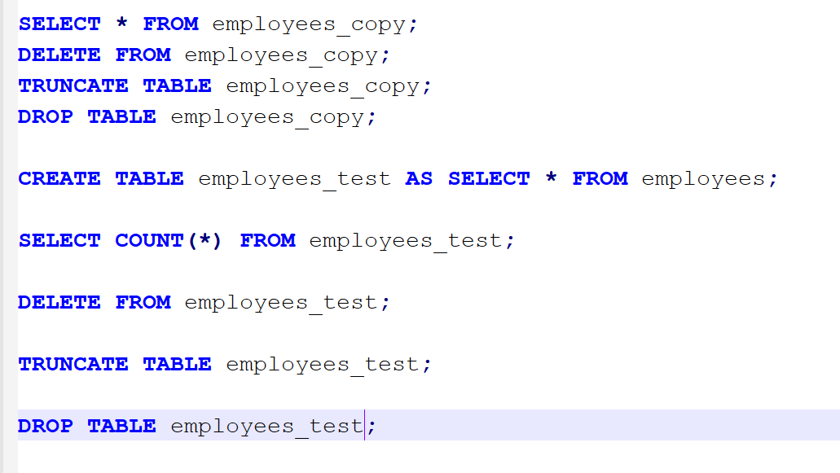
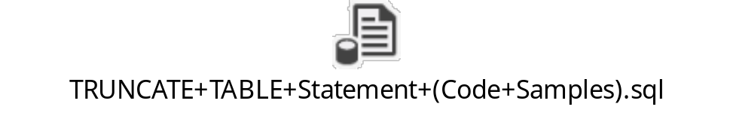
Data Definition Language (DDL) Statements
By Eslam Khder

Slide 26
Data Definition Language (DDL) Statements
RENAME Statement
The RENAME statement is used to change the name of an existing column or table
We can change the name of a column.
We can change the name of a table.
By Eslam Khder

Slide 27
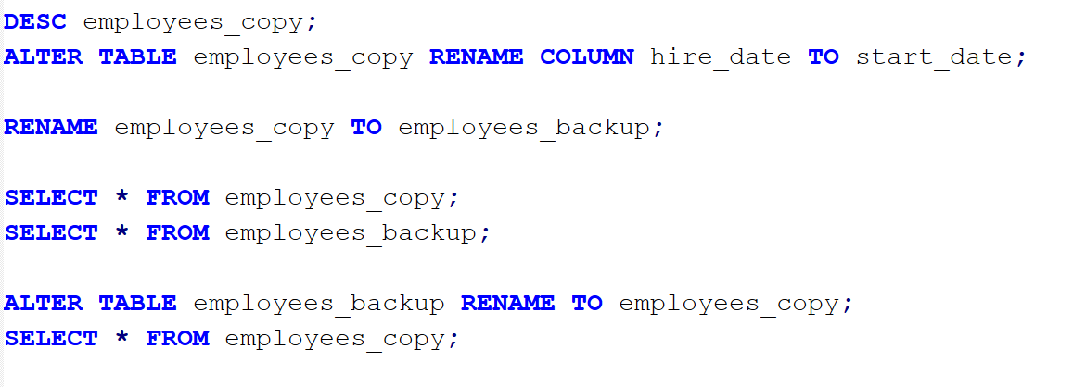
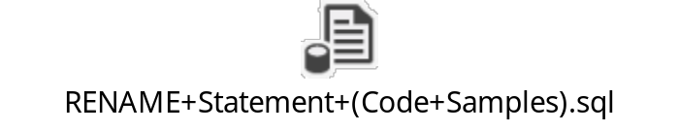
Data Definition Language (DDL) Statements
By Eslam Khder

Slide 28
Data Definition Language (DML) Statements
DML is used to add, update, and delete data.
A collection of DML statements is called a transaction.
A transaction starts with the first execution of a DML statement and finishes with a commit or rollback.
By Eslam Khder

Slide 29
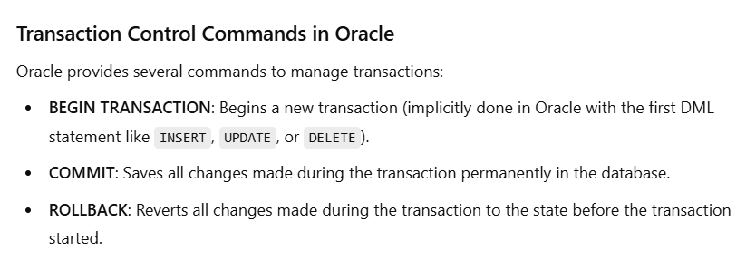
Data Definition Language (DML) Statements
transaction is a sequence of one or more SQL operations (such as INSERT, UPDATE, DELETE) executed as a single unit of work.
By Eslam Khder

Slide 30
Data Definition Language (DML) Statements
INSERT STATEMENT
Use to insert row in table.
By Eslam Khder

Slide 31
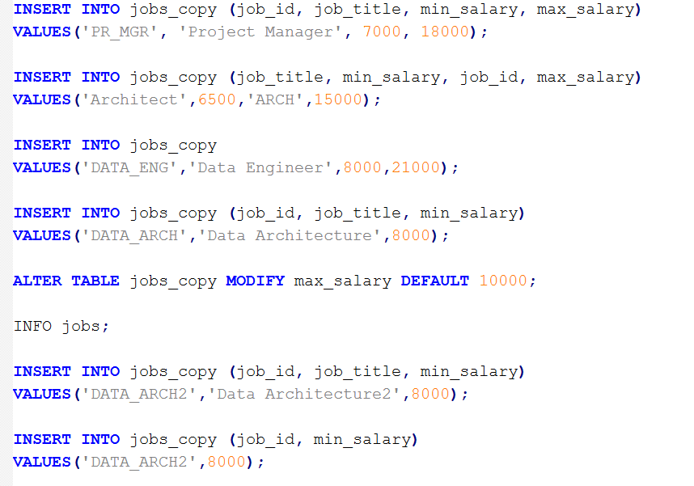
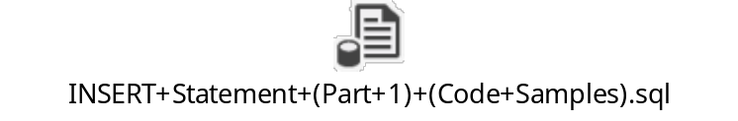
Data Definition Language (DML) Statements
By Eslam Khder

Slide 32
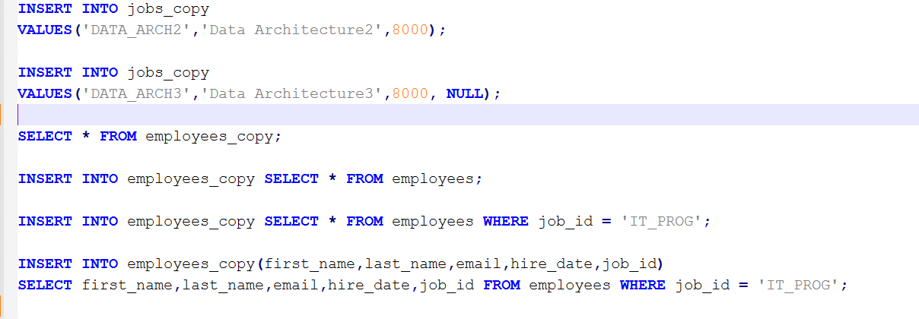
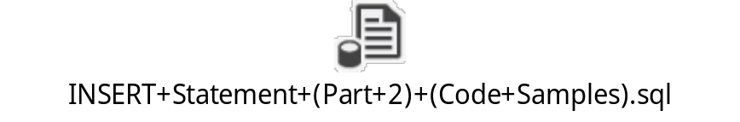
Data Definition Language (DML) Statements
By Eslam Khder

Slide 33
Data Definition Language (DML) Statements
UPDATE STATEMENT
Use to UPDATE row in table.
By Eslam Khder

Slide 34
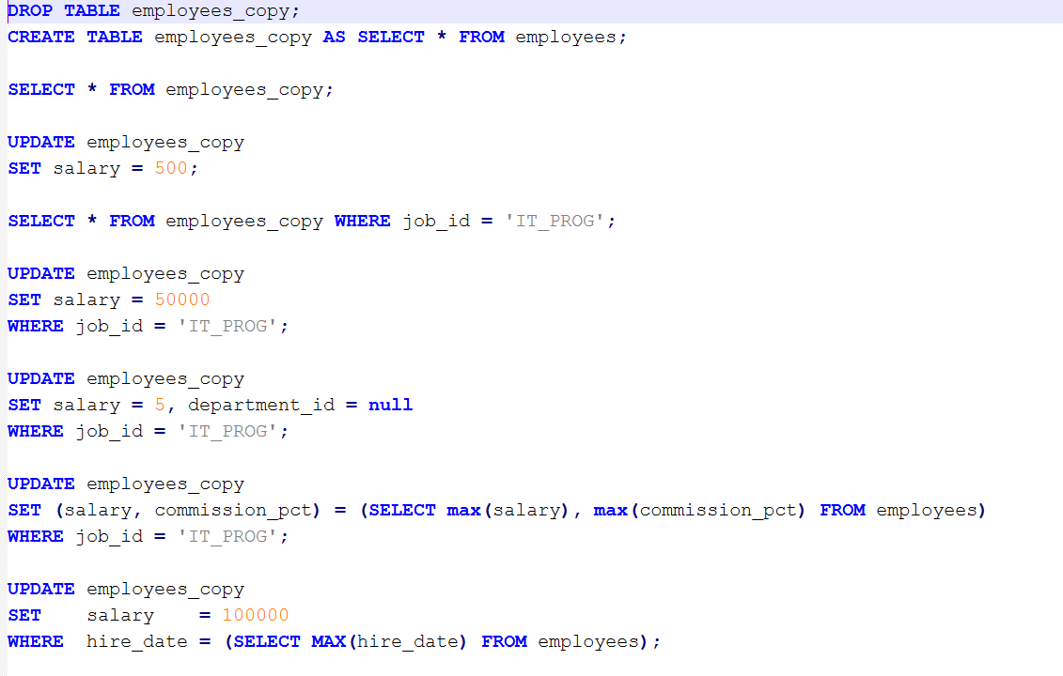

Data Definition Language (DML) Statements
By Eslam Khder

Slide 35
Data Definition Language (DML) Statements
DELETE STATEMENT
Use to DELETE row from table.
By Eslam Khder

Slide 36
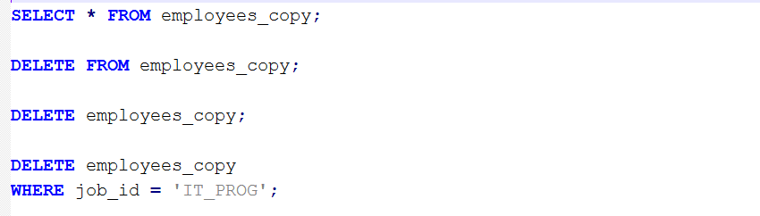

Data Definition Language (DML) Statements
By Eslam Khder

Slide 37

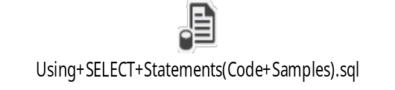


Using+SELECT+Statements
By Eslam Khder

Slide 38
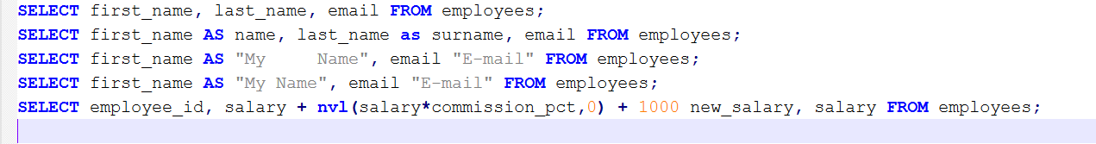
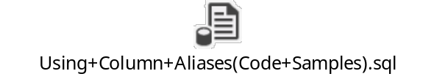
Using Column Aliases
By Eslam Khder

Slide 39
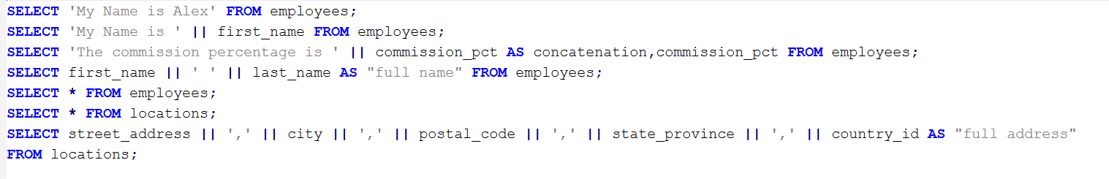

Concatenation Operators
By Eslam Khder

Slide 40
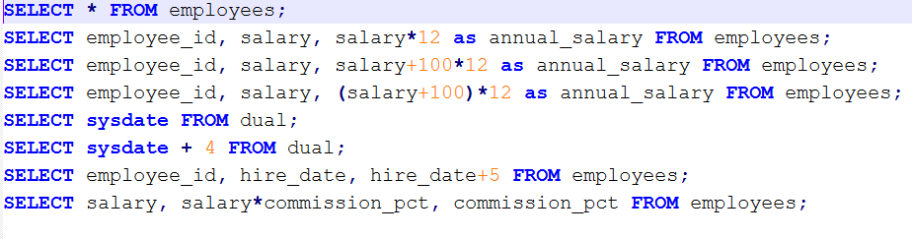

Arithmetic Opertors
By Eslam Khder

Slide 41
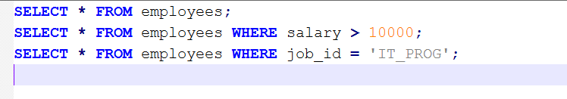

Using WHERE Clause
By Eslam Khder

Slide 42
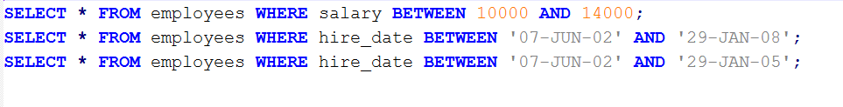

BETWEEN AND Operator
By Eslam Khder

Slide 43
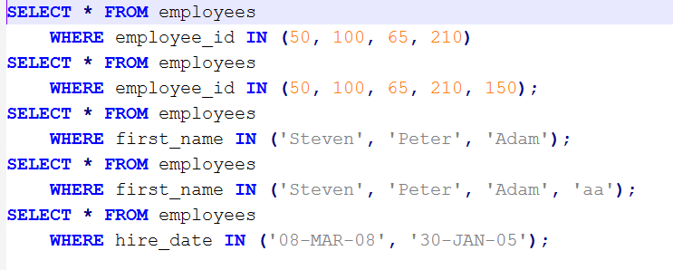

IN Operator
By Eslam Khder

Slide 44
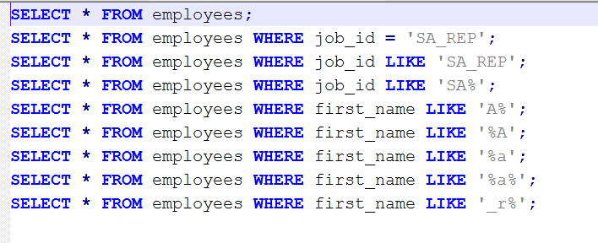

LIKE Operator
By Eslam Khder

Slide 45
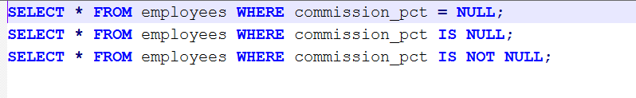

IS NULL Operator
By Eslam Khder

Slide 46
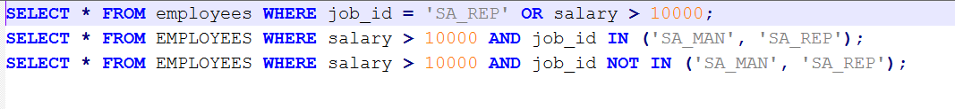

Logical Operators
By Eslam Khder

Slide 47
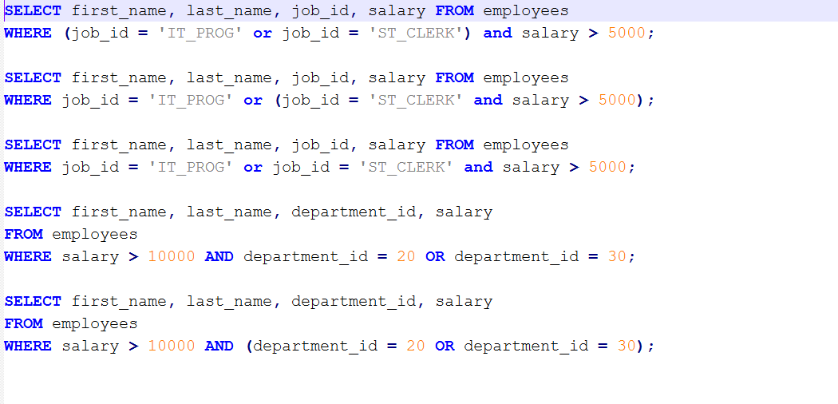
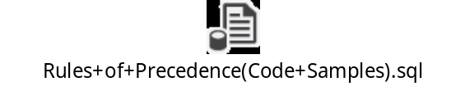
Rules of Precedence
By Eslam Khder

Slide 48
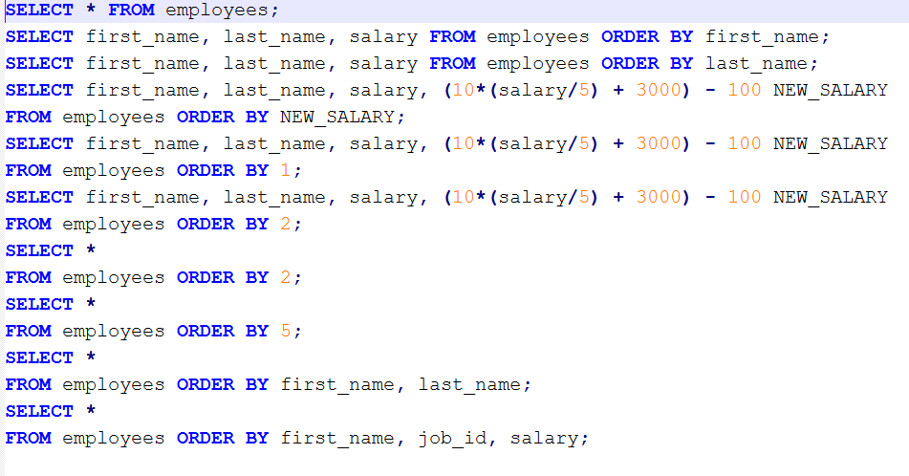

ORDER BY Clause
By Eslam Khder

Slide 49
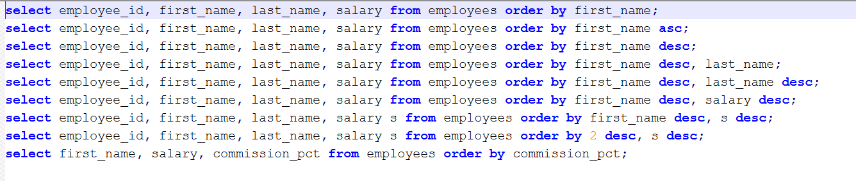

ASC and DESC Operators
By Eslam Khder

Slide 50
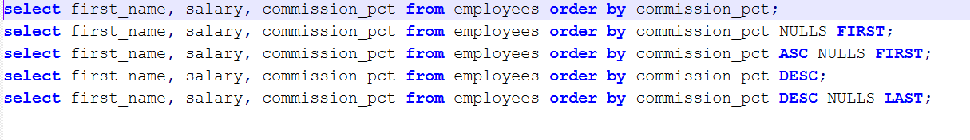

NULLS FIRST and NULLS LAST Operators
By Eslam Khder

Slide 51
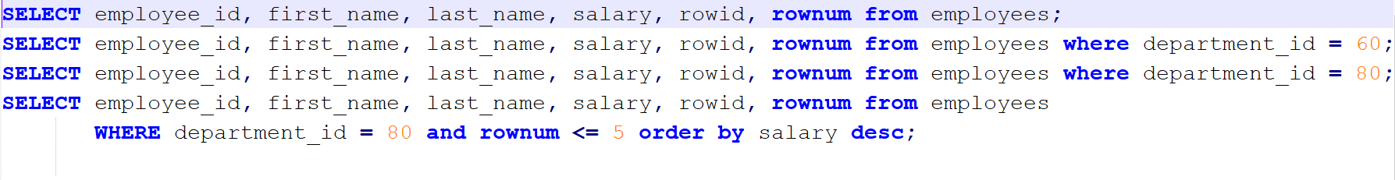

ROWNUM and ROWID
By Eslam Khder

Slide 52
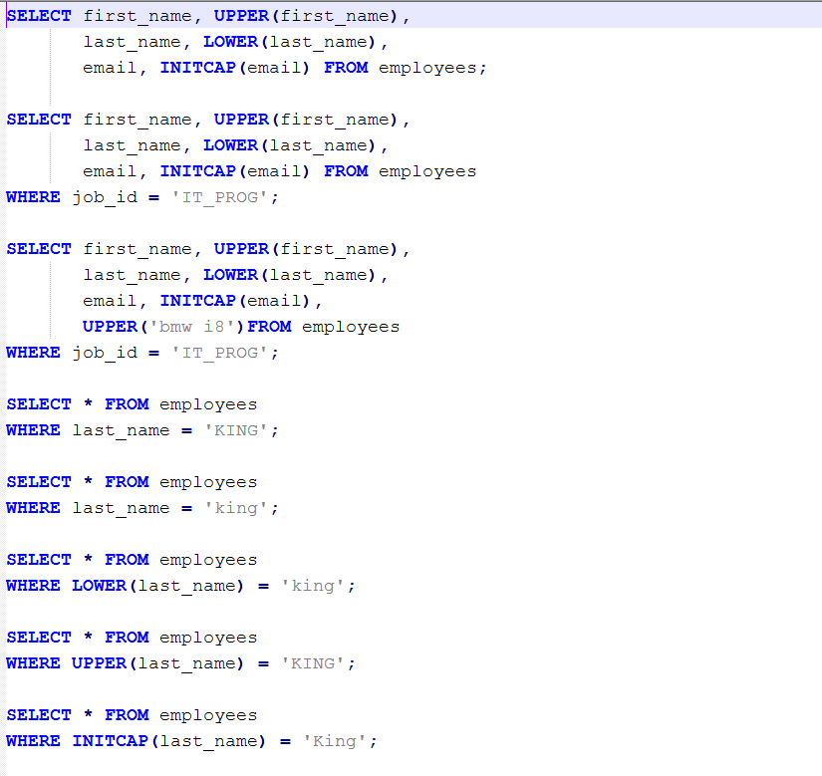

Case Conversion (LOWER,+UPPER,+INITCAP)
By Eslam Khder

Slide 53
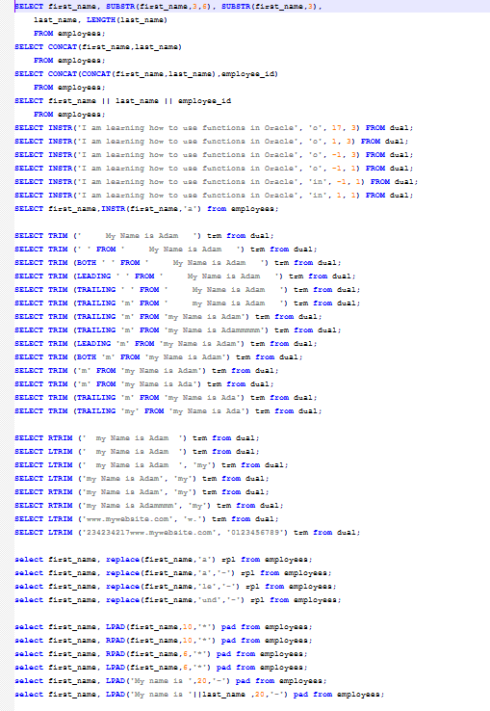

Character Manipulation Functions
By Eslam Khder

Slide 54
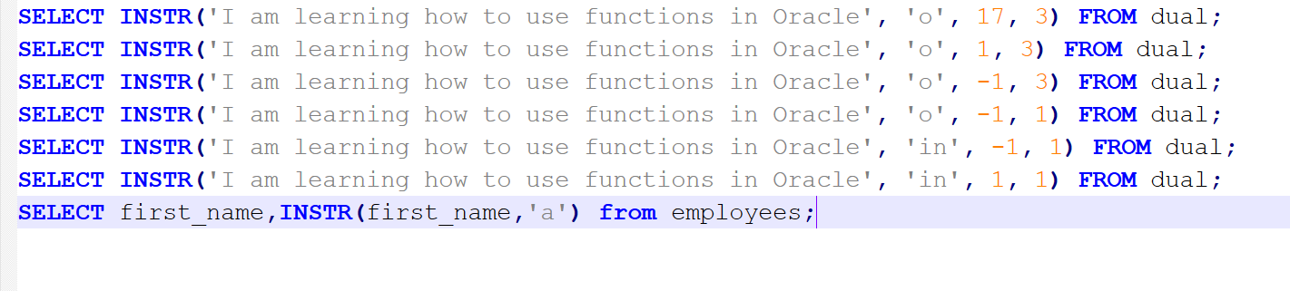
INSTR Function
By Eslam Khder

Slide 55
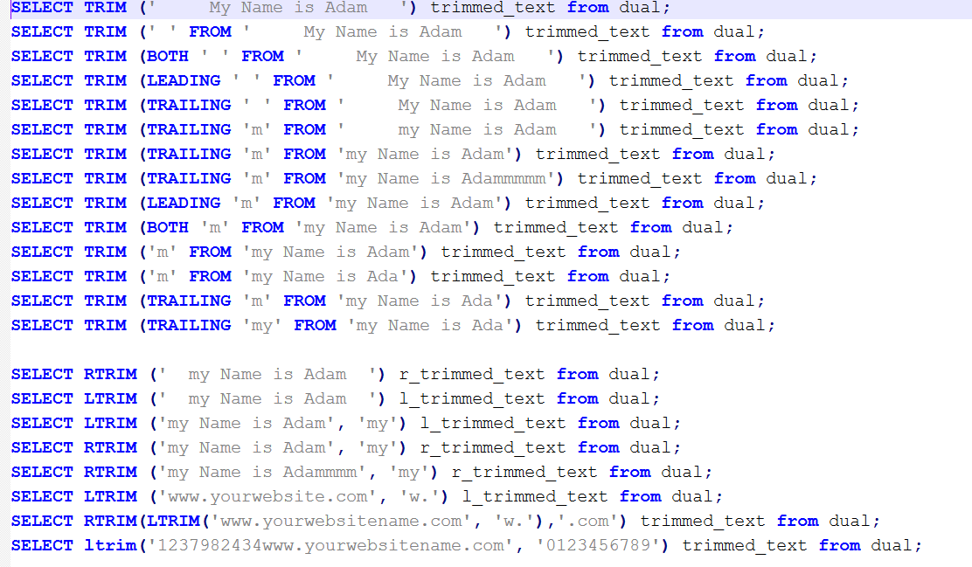
TRIM LTRIM RTRIM Functions
By Eslam Khder

Slide 56
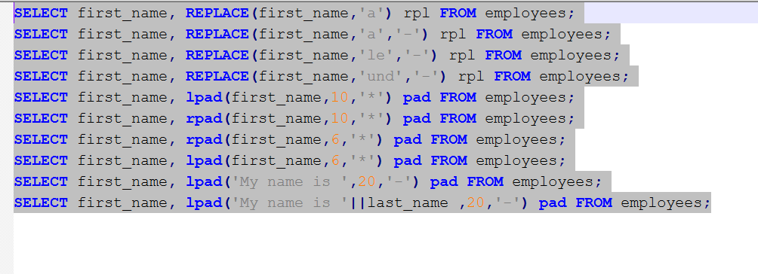
REPLACE LPAD RPAD Functions
By Eslam Khder

Slide 57

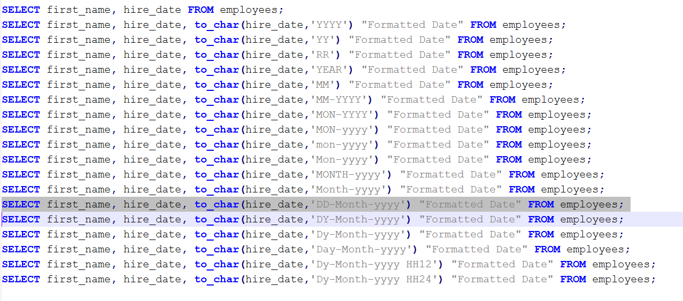
TO_CHAR
By Eslam Khder

Slide 58
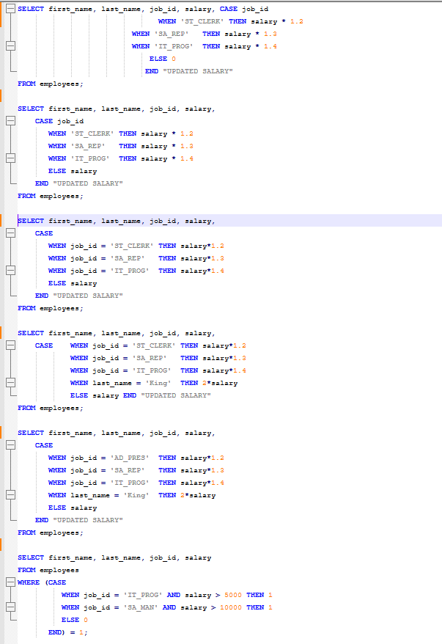

Oracle Conditional+Expressions CASE Expressions
By Eslam Khder

Slide 59
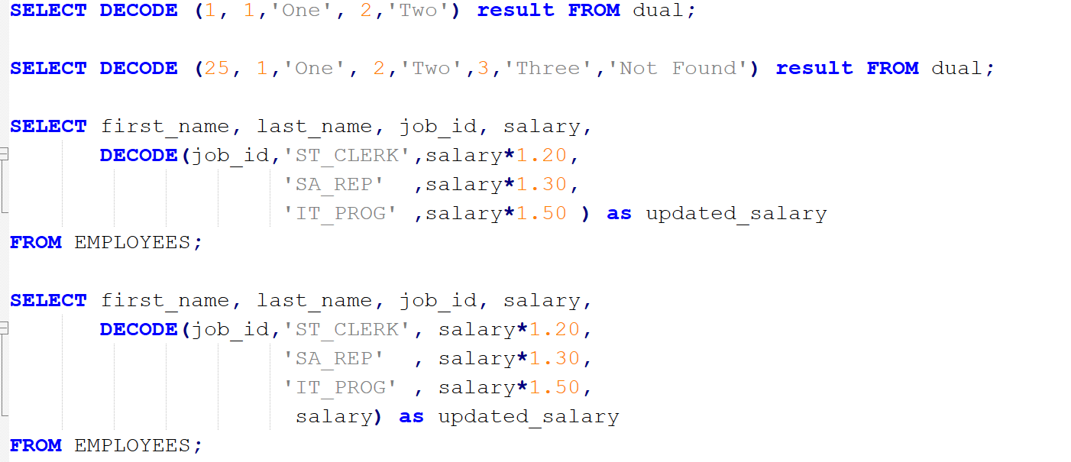

Oracle Conditional Expressions DECODE Function
By Eslam Khder

Slide 60
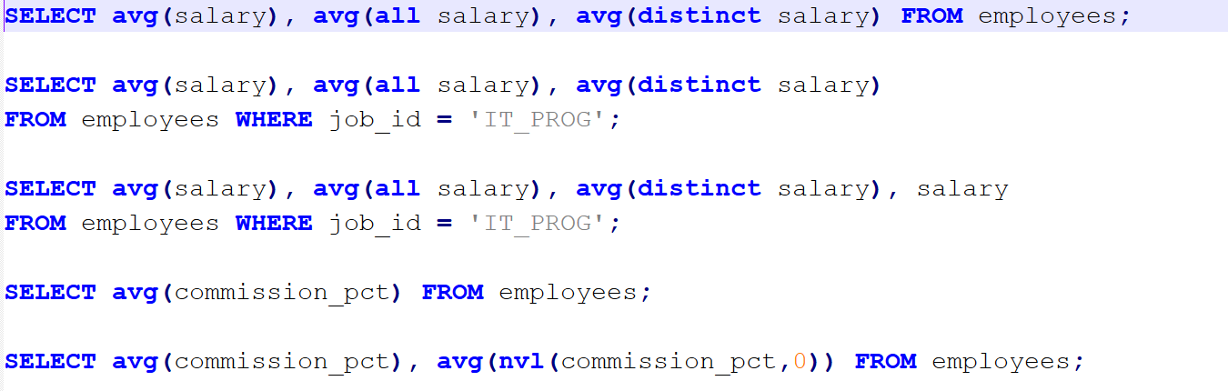
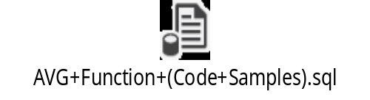
AVG Function
By Eslam Khder

Slide 61
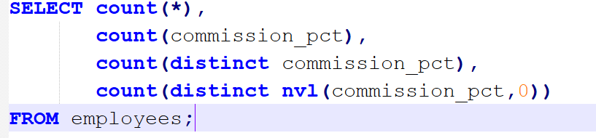

COUNT Function
By Eslam Khder

Slide 62
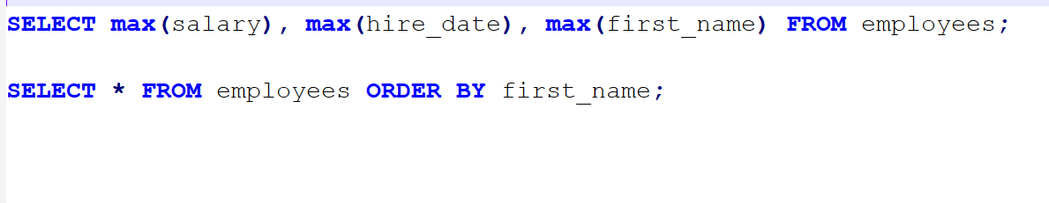
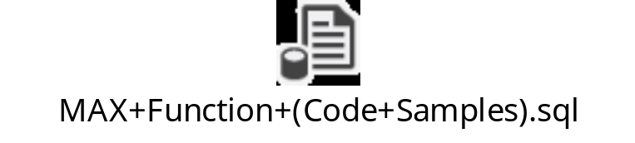
MAX Function
By Eslam Khder

Slide 63


MIN Function
By Eslam Khder

Slide 64


SUM Function
By Eslam Khder

Slide 65


GROUP BY Clause
By Eslam Khder

Slide 66


GROUP BY Clause
By Eslam Khder

Slide 67


HAVING Clause
By Eslam Khder

Slide 68
Join with the USING Clause
Natural Join
LEFT JOIN (or LEFT OUTER JOIN)
  Join with the USING Clause
RIGHT JOIN (or RIGHT OUTER JOIN)
Inner Join
FULL JOIN (or FULL OUTER JOIN)
By Eslam Khder

Slide 69


Natural Join
A NATURAL JOIN in Oracle Database is a type of join that automatically joins tables based on columns with the same name and compatible data types in both tables.
By Eslam Khder

Slide 70


Join with the USING Clause
By Eslam Khder

Slide 71


Handling Ambiguous Column Names
By Eslam Khder

Slide 72


Inner Join Join with the ON Clause
An INNER JOIN returns rows when there is a match in both tables. It is the most common type of join.
By Eslam Khder

Slide 73


Restricting Joins
By Eslam Khder

Slide 74


Outer Join
LEFT JOIN (or LEFT OUTER JOIN)
RIGHT JOIN (or RIGHT OUTER JOIN)
FULL JOIN (or FULL OUTER JOIN)
By Eslam Khder

Slide 75


LEFT JOIN (or LEFT OUTER JOIN)
By Eslam Khder

Slide 76


RIGHT JOIN (or RIGHT OUTER JOIN)
By Eslam Khder

Slide 77


FULL JOIN (or FULL OUTER JOIN)
By Eslam Khder

Slide 78


Using Subqueries
By Eslam Khder

Slide 79


Single Row Subqueries
By Eslam Khder

Slide 80


Multiple Row Subqueries
By Eslam Khder

Slide 81
By Eslam Khder

